Slide 1
SEO Audit
Comprehensive SEO Audit & Optimization for Organic Traffic Growth
Sathana Jaya Mary | MBE11

Slide 2
Company Selection
I picked the firm “COGNIZANT” for this SEO Project.
About Cognizant:
Cognizant helps companies modernize technology, reimagine processes and transform experiences so they stay ahead in a fast-changing world .
Worldwide Footprint:
Cognizant has a significant global presence with operations in over 50 countries and a diverse workforce across multiple continents. Additionally, the company has a strong foothold in AI, leveraging advanced technologies to drive innovation and digital transformation for its clients .

Slide 3
Organizational Profile
The organization operations include:
Delivering business outcomes with cloud solutions.
Empowering Data and AI for better , faster decision making.
Business intuition to supercharge performance.
To run a modern business on apps fit for purpose and the future-Modernize, Reinvent and Run strategy for application services.
The organization gives 360 degree security outcomes.
Cognizant follows numerous number of advanced strategies and services for its customers.

Slide 4
Project Tasks 1.Initial audit:
Current Status:
The website's pages contains a wealth of information, presenting it in a clear and straightforward manner. The details are well-organized and concise, ensuring that users can easily grasp the essential points without any confusion.
Advantages:
The website’s backdrop is dynamic and eye catching.
All CSS Files appears to be compacted.
Disadvantages:
Some images on the page has no alt attribute.
The server is not using “expires” headers for the images.

Slide 5
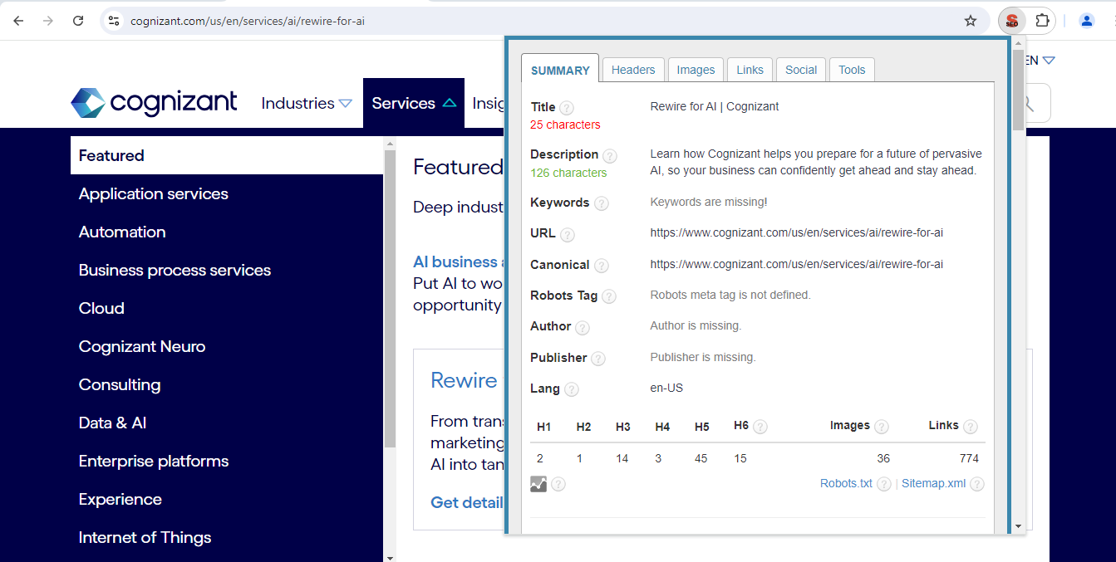
2.Keyword Research:
No keyword is targeted properly in any of the pages.

Slide 6
3.ON-Page SEO Optimization Audit
Chosen Pages :Turning potential to profit: building consumer trust in AI (cognizant.com)
Advantages:
The Insight page features additional charts that illustrate their growth and development, enhancing the page's visual appeal.
The page offers a wealth of information presented in a clear and well-organized manner.
Disadvantages:
The meta description is 229 characters long, which is too long.
The page makes 27 requests. More than 20 requests can result in slow page loading.
The page makes 27 requests. More than 20 requests can result in slow page loading.

Slide 7
4.Technical SEO(Homepage)
Effective Strategies for Boosting Site and Page Speed
Keywords should be targeted not only on the homepage but also on other pages to help increase the website’s ranking.
JavaScript files should be minified to reduce their size and improve site performance.
The page makes 29 requests. Since more than 20 requests can slow down loading times, minimize them to improve performance and user experience.
Two H1 tags were found. For optimal SEO results, each page should have exactly one H1 tag to ensure proper hierarchy and better search engine visibility.
The robots meta tag is missing. To improve search engine indexing and control how search engines interact with your page, it is recommended to include this Tag with the appropriate directives.

Slide 8
5. Content Strategy:
Whitepapers and E-books: Offer downloadable resources on key topics such as digital transformation or AI in business. These can attract leads and improve SEO through additional traffic and engagement.
Webinars and Video Content: Create and share video content and webinars on relevant topics. Optimize video titles, descriptions, and tags for SEO.
Industry News and Insights: Regularly update the blog with the latest industry news, trends, and expert insights to engage visitors and attract organic traffic.
Client Success Stories: Develop case studies and success stories highlighting how Cognizant’s solutions have benefited clients. This not only builds credibility but also attracts search traffic for industry-specific solutions.

Slide 9
6.Off-Page SEO:
Guest Blogging: Write guest posts for reputable industry blogs and publications. This not only earns backlinks but also positions Cognizant as a thought leader in the tech and consulting space.
Influencer Collaboration: Partner with industry influencers to create and share content. Influencers can drive traffic and provide valuable backlinks from their established platforms.
Content Gap Analysis: Identify content gaps by reviewing competitors’ strategies. Create superior content to fill these gaps and attract backlinks and traffic.
Social Signals: Encourage employees, partners, and satisfied clients to share and engage with your content. Social signals can indirectly influence SEO performance.

Slide 10
Project Outcomes: 1.Enhance On-Site SEO Elements: Based on the findings, focus on optimizing key on-site factors such as title tags, meta descriptions, header tags, and content to improve search engine visibility. 2. Execute a Comprehensive Link-Building Strategy: Formulate and apply a robust off-page SEO plan to acquire high-quality backlinks and increase brand recognition. This involves techniques such as guest posting, influencer collaborations, and social media outreach. 3. Develop a Strategic Content Plan: Create and implement a content strategy that includes targeted keyword integration to attract relevant traffic and boost search engine rankings.

Slide 11
Summary:
This SEO audit report serves as a foundational guide for enhancing Cognizant’s online visibility and improving search engine rankings. By implementing the recommended actions and strategies outlined in this report, the company can achieve significant improvements in its digital presence and overall search performance.

